Slide 1
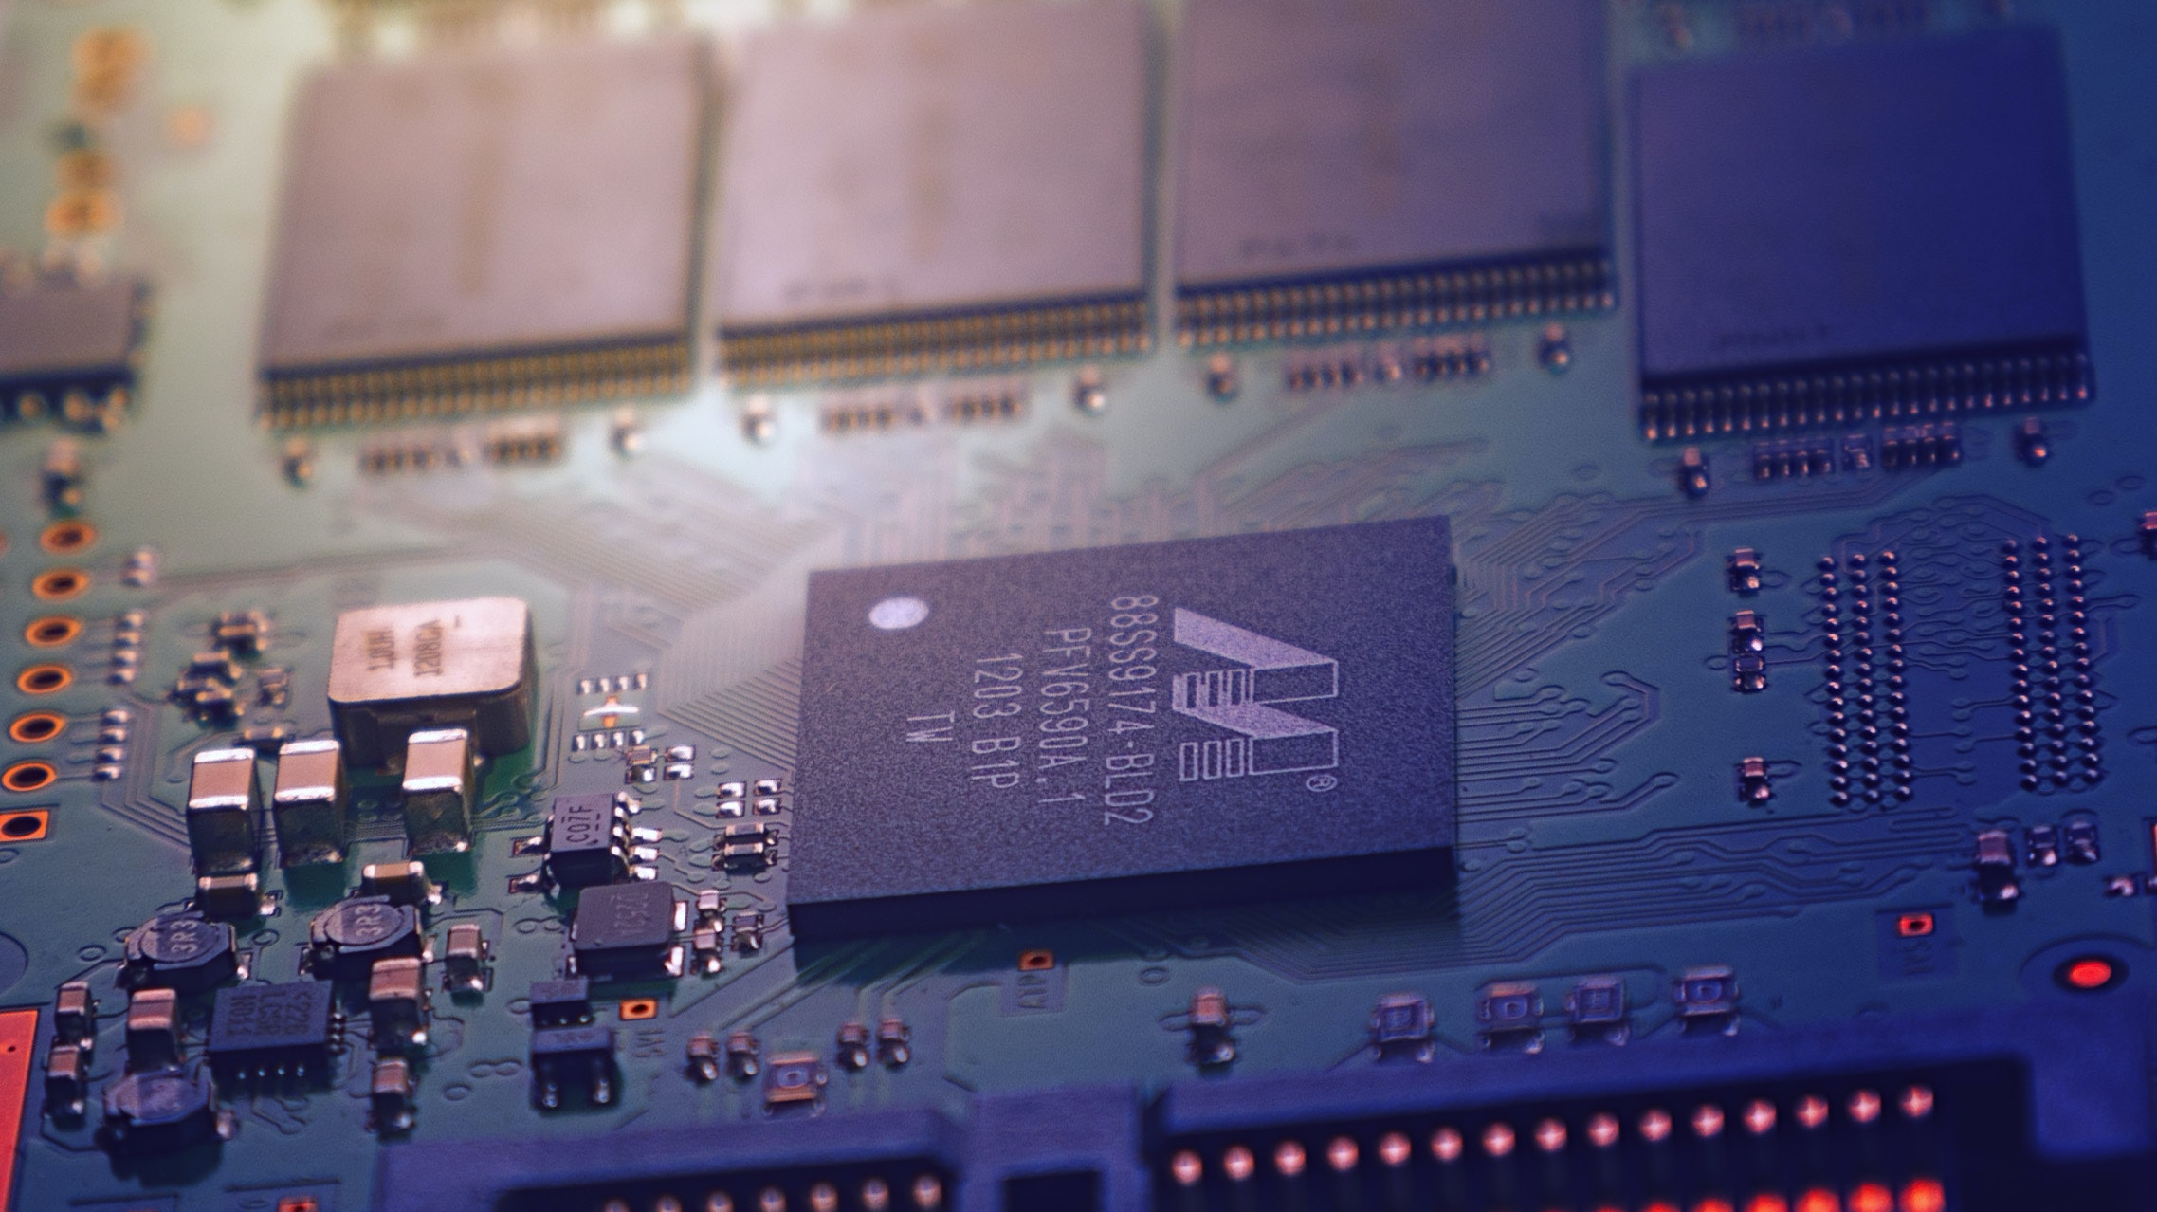
IOT ALCOHOL DETECTION AND IGNITION LOCKING MECHANISM WITH CELLULAR ALERTS PROJECT PROPOSAL
by
OWEN ONDIEKI
&
DOMINIC SAKWA
SUPERVISOR:
DR. LAWRENCE NGUGI

Slide 2

INTRODUCTION
Urgency in combating drunk driving's dire consequences drives the quest for a proactive technological solution.

Slide 3
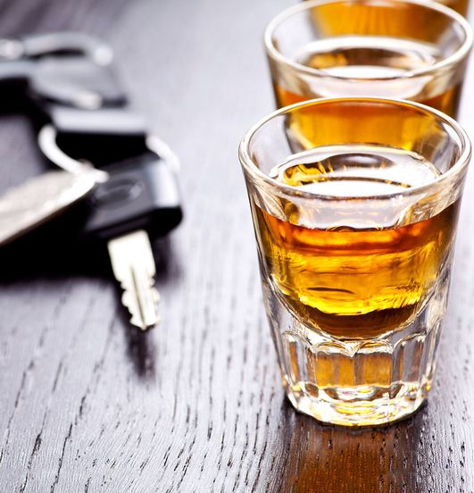
Background study
- Road accidents due to drunk driving leads to thousands of annual deaths & economic repercussions – amounting to approximately $44 billion each year in the US.
- Challenges have been met in reducing intoxicated driving using legacy methods like breathalyzers.
- Limitations of alcohol detection systems using sensors like MQ3 Gas Sensor have necessitated advancements in AI and ML to improve said systems.
- Convolutional Neural Networks (CNNs) and Decision Trees (Random Forest) are preferred for accuracy and lower computational requirements in identifying intoxicated drivers through facial recognition.

Slide 4
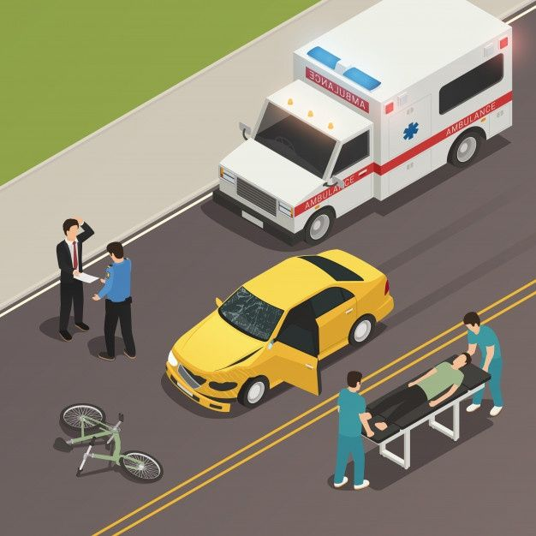
2. Problem statement
- Driving Under Intoxication (DUI) presents dangers such as Impaired judgment, delayed reaction time and poor coordination that increase probability of road accidents.
- Past solutions such as carpooling, blood and urine tests and wearable alcohol biosensors have proven ineffective in various capacities.
- Challenges with existing detection systems are characterized by inaccuracy, ignition control and real-time communication.
- Our proposed system seeks to provide accurate intoxicated driver detection, Ignition interlocking and GSM/GPS technologies for communication and tracking.
- This promises significant road safety enhancement.

Slide 5
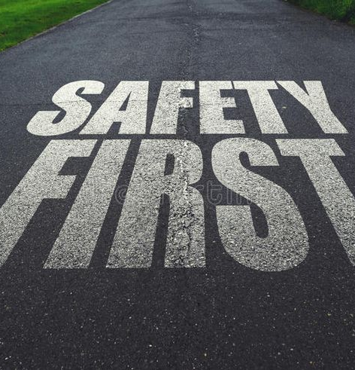
3. Justification
- Road transport is crucial for commercial and leisure travel hence the need to address alcohol-related accidents (which contribute to 30% of total road incidents).
- Safety enhancement is thus crucial for saving lives, time and resources.
Our proposed system counters the effects of alcohol induced road accidents by providing;
- Economic benefits: Victims in productive years contribute to industries.
- Relief from financial burden of treating injured loved ones.
- Prevention of long-term impairments that impact productivity.

Slide 6

Objectives
Data Collection
Data Preprocessing
Classifier Selection
Data Splitting
Training and Evaluation
Model Optimization
Integration of Alcohol Sensor
GSM Integration
GPS Integration

Slide 7
Scope and Limitations
The project aims to proactively reduce DUI-related road accidents by using ML in facial recognition and classification, specifically the Random Forest algorithm, to assess a driver's sobriety accurately
The system will provide two outputs: SOBER, allowing normal vehicle operation, and DRUNK, which will prevent ignition and send an SMS alert to a preprogrammed third party with the driver's status and location using GSM and GPS technologies.
Limitations include the absence of an Android or web application for direct communication with authorities and not utilizing video for facial recognition, which could potentially yield better results.

Slide 8

Literature Review

Slide 9
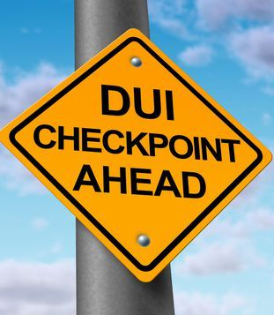
Overview
Various methods have been employed to combat Driving under the Influence (DUI). Sobriety checkpoints using Breathalyzers have been used but led to highway congestion. Intensive Supervision Programs, involving alcohol testing and education, were effective only briefly.
A low-cost Breathalyzer ignition interlock proposed by Yik Lung measured blood alcohol content (BAC) before starting a vehicle but lacked real-time monitoring and alerting capabilities.
Wearable alcohol biosensors monitored BAC continuously but lacked the ignition interlock feature.
Community-based approaches, like designated driver programs, depended on cooperation and awareness. Policy measures suggested included lowering BAC limits and publicizing checkpoints but still had limitations.
Autonomous vehicles with advanced sensors and networking were seen as a future solution to prevent accidents.

Slide 10
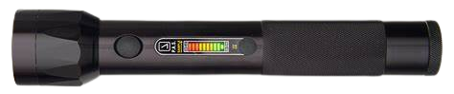
Commercially Available Solutions
Passive Alcohol Sensors
Breathalyzer Apps
Ride sharing and taxi services
Designated Driver Programs
Ignition Interlock Devices (IIDs)

Slide 11

Research gaps
Lack of real-time monitoring and alerting capabilities
Previous methods did not employ image recognition techniques for drunkenness detection
Previous methods relied on physical intervention from authorities
- Proposed system: Provides proactive approach for real-time DUI detection.
- Combines image recognition and alcohol sensor technology for accurate BAC measurement.
- GPS and GSM for precise timing and location cellular alerts.

Slide 12

METHODOLOGY
The methodology proposed to be employed for modelling this system involves obtaining a dataset comprising images that will be classified into sober and drunk states. This ML model will be integrated with the ignition interlock and communication system peripherals.

Slide 13
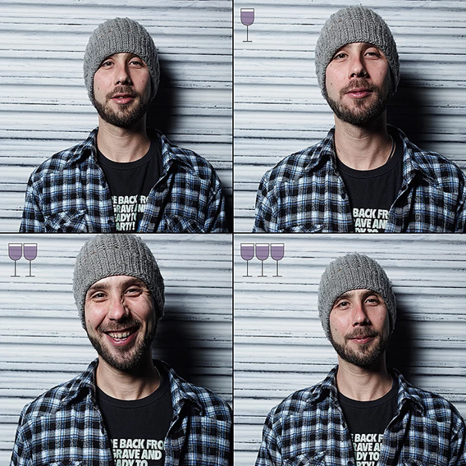
Dataset
This project will employ the "Three Glasses Later" dataset by Marco Alberti, capturing individuals while sober and after consuming wine.
These facial images will help test and train the ML model accurately.
Image augmentation will be used to incorporate photos with varying conditions, such as off-center faces, diverse perspectives, and lighting, to offer a better reflection of real-world scenarios in the dataset enhancement process.

Slide 14
Facial feature selection and calculation
Pixel Intensity Features | Raw Pixel Values Histograms of Pixel Intensities Local Binary Patterns (LBP)
Geometric Features: | Facial Landmarks: Distances, Ratios, and Angles: Calculate facial measurements.
Texture Features: | Gabor Filters Local Binary Patterns (LBP)
Statistical Features: | Mean, Variance, Skewness, and Kurtosis
Feature selection and calculation are vital in facial recognition.

Slide 15

Compare classifiers to optimize classification accuracy
Performance metrics, including accuracy, assesses ML model effectiveness.
Comparison of SVM, Random Forest and k-NN classifiers will be done using MATLAB to determine the best classifier for detecting facial drunkenness accurately.

Slide 16
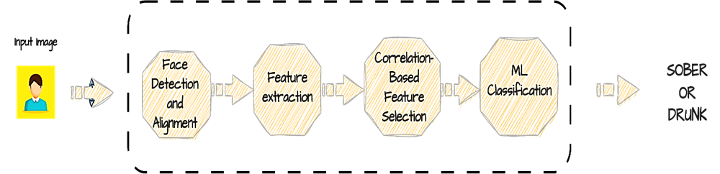
Intoxication detection image pipeline

Slide 17

Integration of the ML model and deployment
Model Conversion
Model Transfer
Install Runtime Environment
Load and run the model on the Raspberry Pi
Deploy and integrate the model into the Raspberry Pi
Optimization to ensure efficient performance on Raspberry Pi
Testing

Slide 18
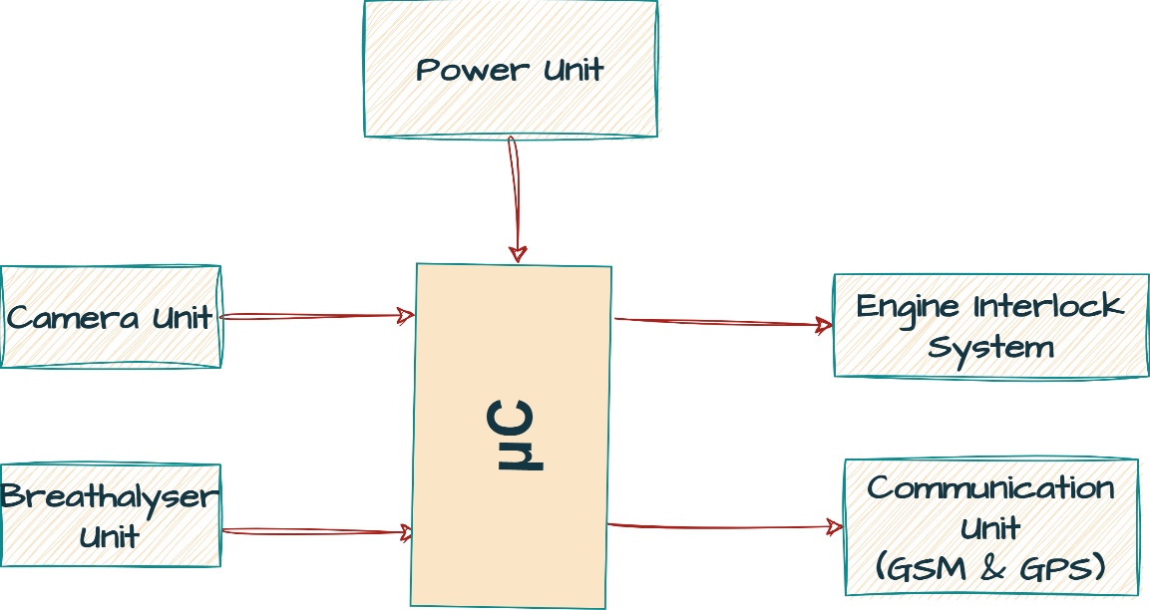
System Block Diagram

Slide 19
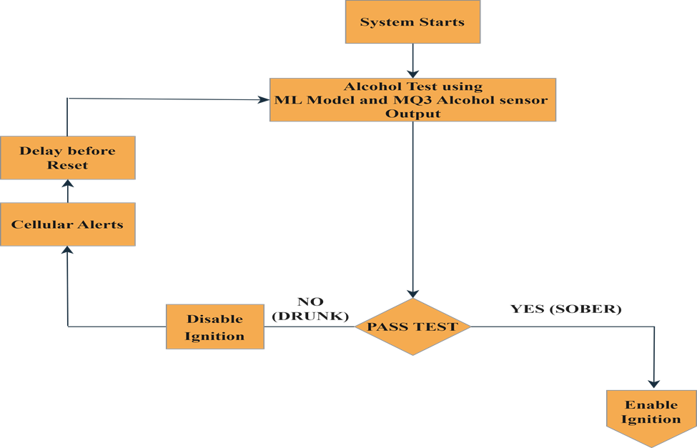
System operation flow

Slide 20
Peter Miller
Peter Miller discusses non-invasive monitoring methods to combat DUI, including sobriety checkpoints where officers use Breathalyzers to check drivers' Blood Alcohol Content (BAC). However, this approach often led to highway congestion. He also mentions Intensive Supervision Programs, which employ measures like randomized alcohol testing, license sanctions, and driver education. These programs were effective but mainly in the short term.
Yik Lung
David Stanley
Elise shore
Uhlemann

Slide 21
Peter Miller
Yik Lung proposed a low-cost Breathalyzer ignition interlock system to prevent DUI. This electronic device would be installed in a vehicle's ignition system, measuring the driver's blood alcohol content (BAC) before allowing the vehicle to start. However, it lacked real-time monitoring and the ability to send immediate alerts to authorities or the driver's family, limiting its effectiveness.
Yik Lung
David Stanley
Elise shore
Uhlemann

Slide 22
Peter Miller
David Stanley discusses wearable alcohol biosensors that continuously monitor Blood Alcohol Content (BAC) levels through transdermal monitoring using sweat and skin interstitial fluid. However, there hasn't been research on integrating this technology with vehicles to provide ignition interlock mechanisms, potentially limiting its application for preventing DUI.
Yik Lung
David Stanley
Elise shore
Uhlemann

Slide 23
Peter Miller
Elsie Shore's work introduces community-based approaches for preventing DUI incidents, highlighting designated driver programs that rely on community, friend, and expert cooperation to discourage intoxicated individuals from driving. While successful in some cases, the effectiveness varies due to the need for cooperation from both drinkers and communities. Additionally, the book delves into research on improving vehicle interlock programs to address drunk driving accidents, offering a multifaceted approach to tackling this issue.
Yik Lung
David Stanley
Elise shore
Uhlemann

Slide 24
Peter Miller
Uhlemann discusses autonomous vehicles and the potential for further research to enable them to prevent accidents. Autonomous vehicles operate and navigate without human intervention, equipped with sensors, cameras, radar, GPS, and advanced computer systems that allow them to perceive their surroundings and make safe and efficient decisions. When connected through a network, these vehicles can collectively make intelligent decisions on the road. The implementation of connected autonomous vehicles is seen as a promising strategy for preventing road accidents in the future.
Yik Lung
David Stanley
Elise shore
Uhlemann

Slide 25

THE END
QUESTIONS?
FEEDBACK?
THANK YOU FOR YOUR ATTENTION

